Slide 1

News Media Bias
Brian Pan

Slide 2


Outline
Scraping/Coding Issues
Left-leaning, Right-leaning
Moderate
Overall trends
Findings

Slide 3

Common Issues
First division is the menu/site heading
Specific IDs/tags
A lot of noise
Differing classes
Extracted text contains html tags

Slide 4
Common Issues
First division is the menu/site heading
Targeting labels
Specific IDs/tags
Customizing IDs/tags
A lot of noise
Adding removal lines
A lot of nested class
Using find_all or targeting subclasses
Extracted text contains html tags
Iterating values into another object

Slide 5
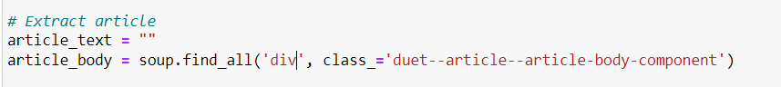
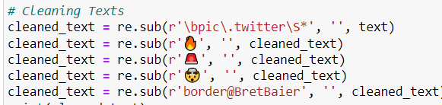
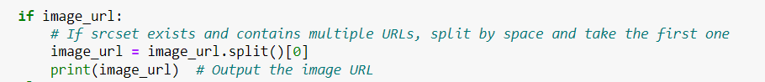
Common Issues

Slide 6
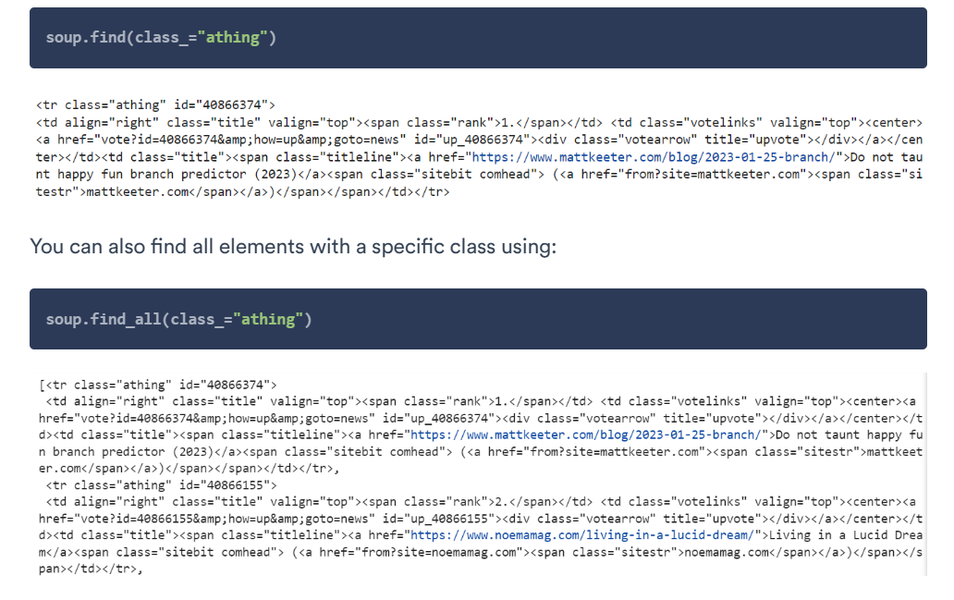
Resources

Slide 7
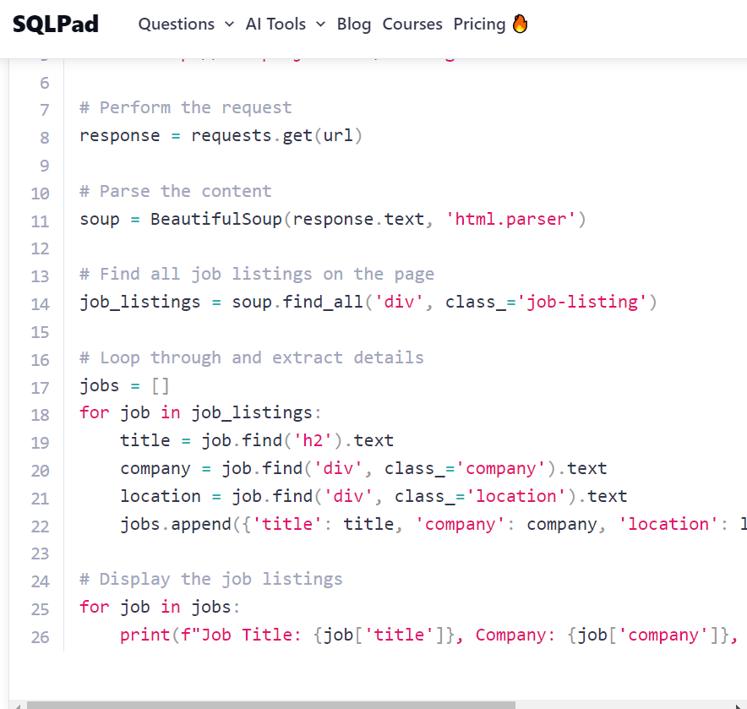
Resources

Slide 8




Scraping
 | Personal Code | Simple Scraper | Instant Data Scraper | BrowseAI
Setup Requirement | High | Low | Low | Medium – Sign up required
Cost | Free | Free | Free | Free until trial limit reached
Format Extraction | Any | CSV/ JSON | CSV / XLSX | CSV/JSON
Customizable | Yes | Yes | No | Yes
Guides Available | No | Yes | Yes | Yes
Support available | No | Yes | No | Yes
Unique Features | Customizable per scraping needs | Has recipes (formatting for specific scrapes) | Has option to scrape infinite scroll | Robots – custom recipes tailored for specified sites
Easy to scrape multiple | Yes with recipe | Yes with recipe | No | Yes with robot
Data Formatting | None | Yes | Yes | Yes

Slide 9
Scraping
 | Personal Code | Simple Scraper |  | BrowseAI
Strengths | Free, easy to format, easy to import, easy to customize. | Free, easy to scrape, easy to create recipes | Free, easy to scrape, can do infinite-scroll websites | Professional support available. Easy to scrape and create ‘robot’ recipes.
Limits | Requires customization for each website, labor intensive, | A lot of formatting issues when importing data. Most pressing issue is the inability to encode utf-8. | Cannot choose which content to scrape. Data is disorganized. | Primarily a paid platform, but free trial is available until threshold data is reached.

Slide 10
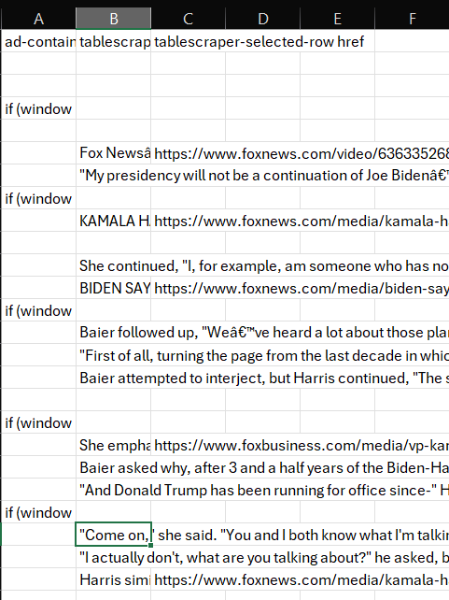
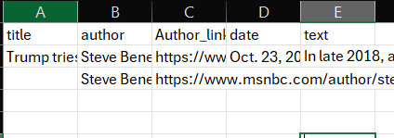
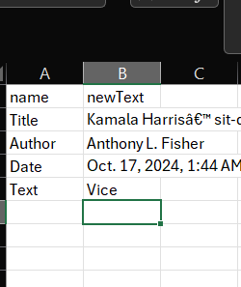
Simple Scraper | Instant Data Scraper | Browse AI

Slide 11
News Media Bias
Brian Pan

Slide 12





How can voters effectively navigate the plethora of news to make good decisions at the ballot?

Slide 13



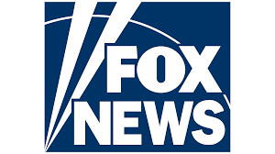
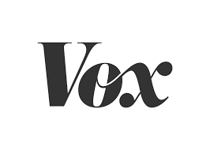

Comparing Articles
 | Left-Leaning | Right-Leaning
Debt
Border
Guns

Slide 14
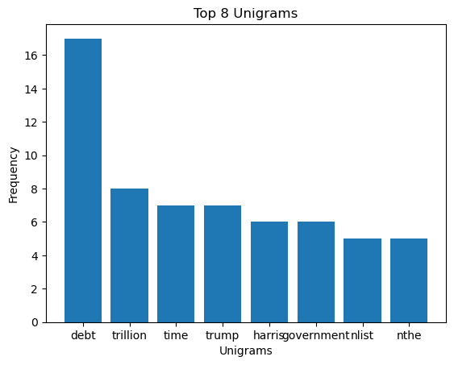
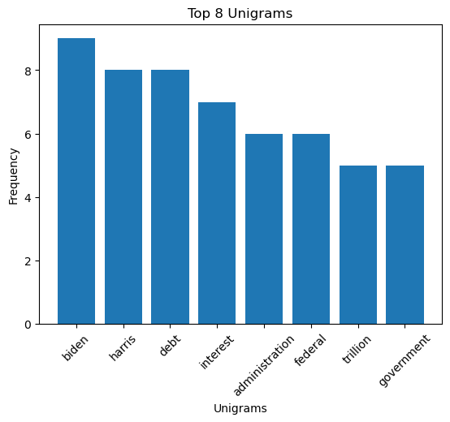
Comparing Debt

Slide 15




Comparing Debt
Noting the difference in most frequent unigrams here, The contrast is significant.

Slide 16
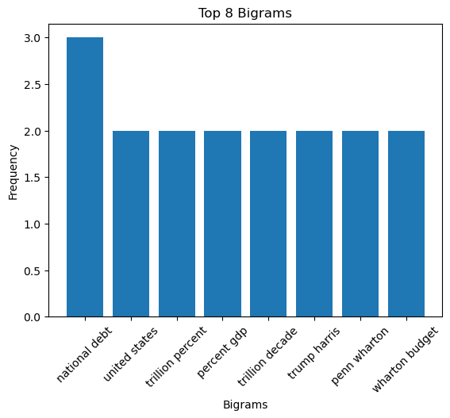
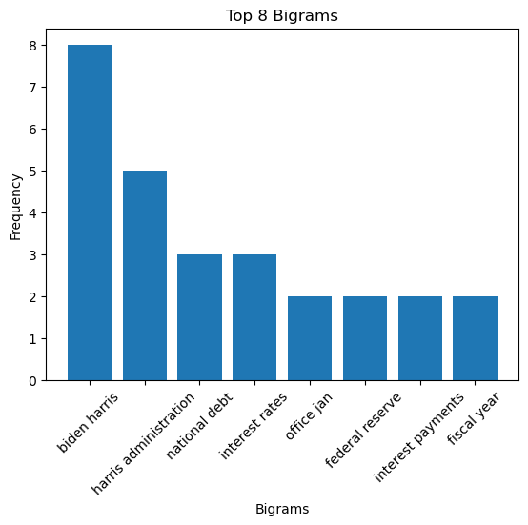
Comparing Debt

Slide 17

Comparing Debt
The frequent mention of the harris-biden administration may suggest this news is associating this administration with the debt issue.

Slide 18
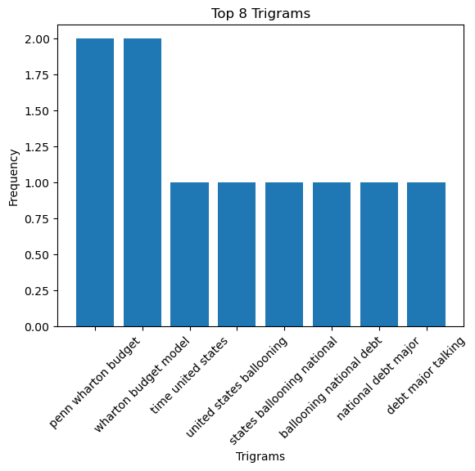
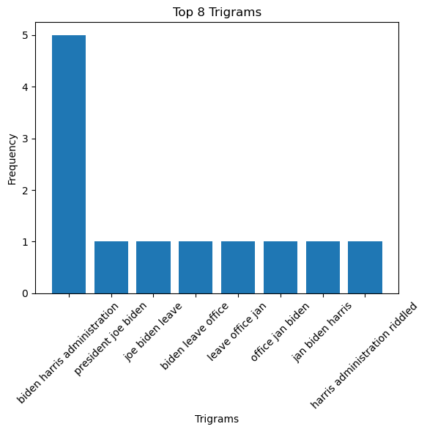
Comparing Debt

Slide 19

Comparing Debt

Slide 20
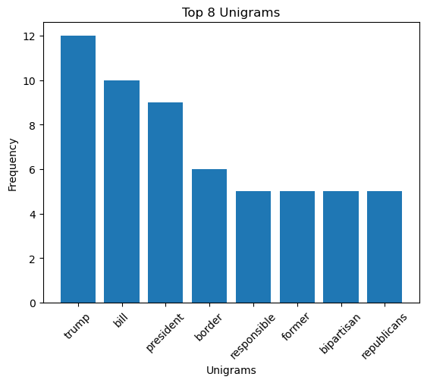
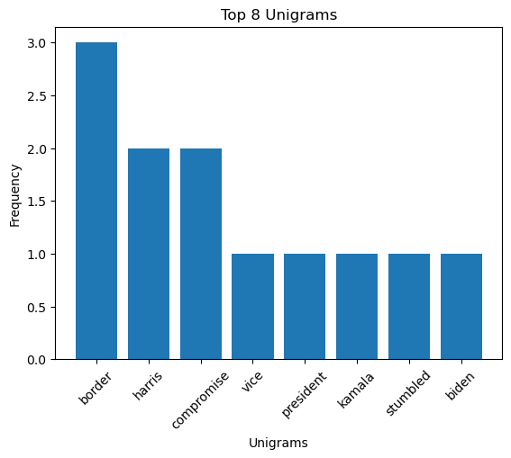
Comparing Border

Slide 21


Comparing Border
On the border issue, it seems MSNBC is associating the border issue with the Trump administration

Slide 22
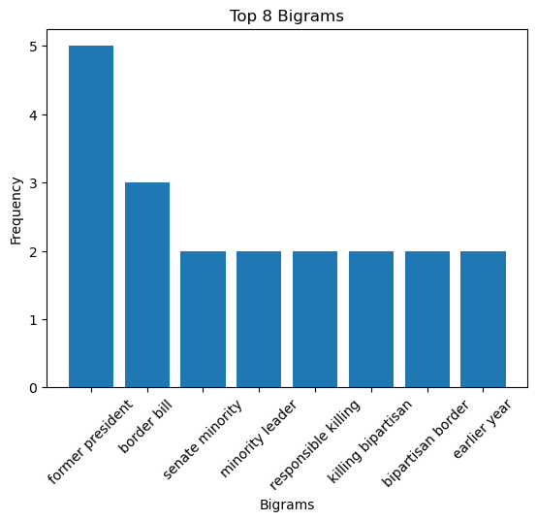
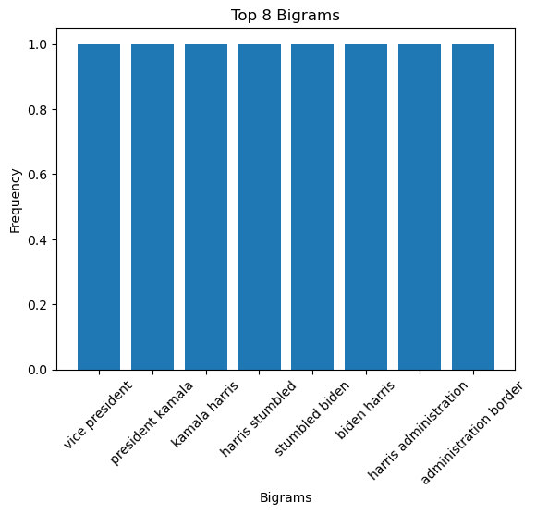
Comparing Border

Slide 23
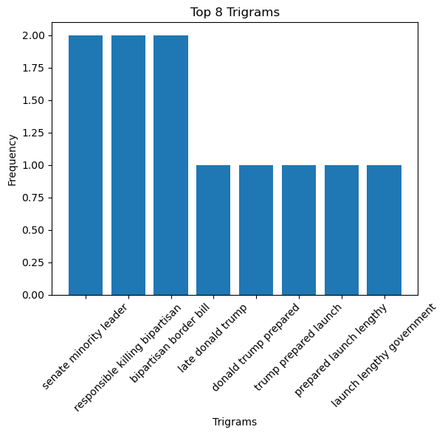
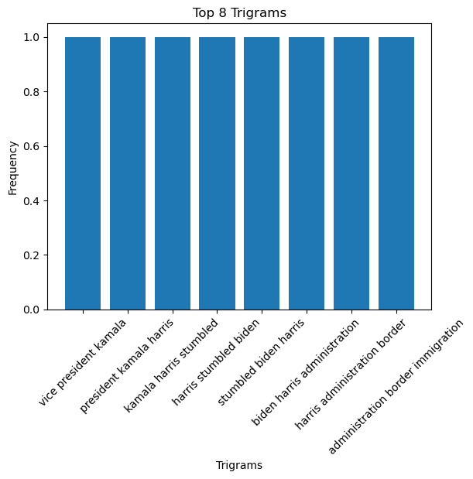
Comparing Border

Slide 24
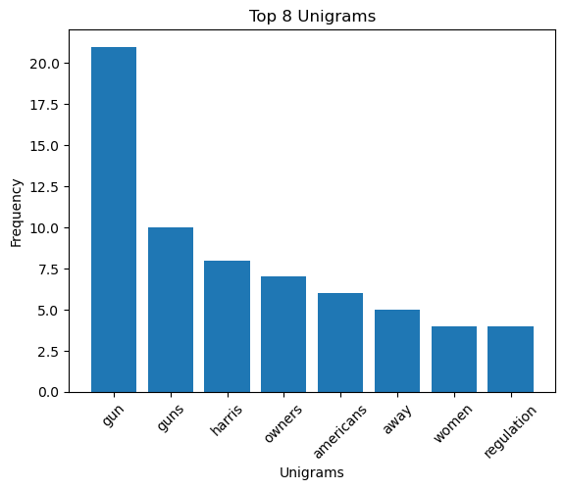
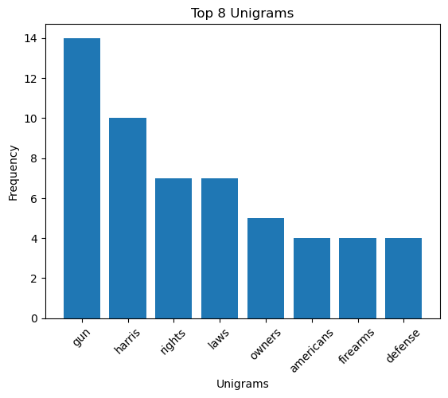
Comparing Guns

Slide 25



Comparing Guns
A contrast of unigrams gives insight into differences in values

Slide 26
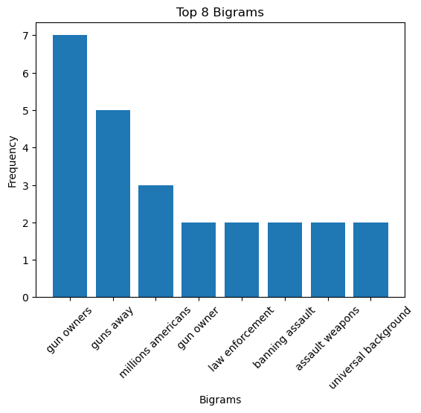
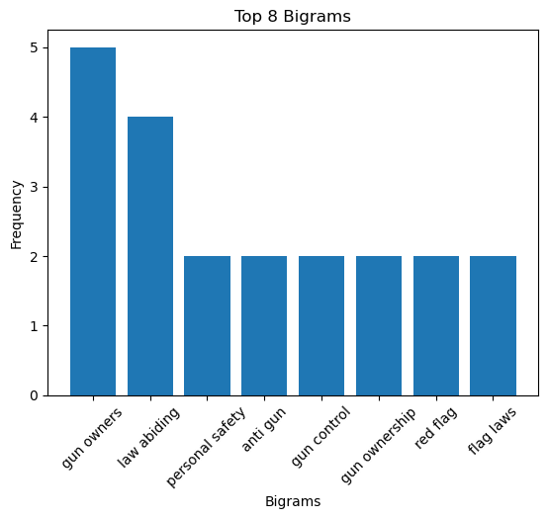
Comparing Guns

Slide 27
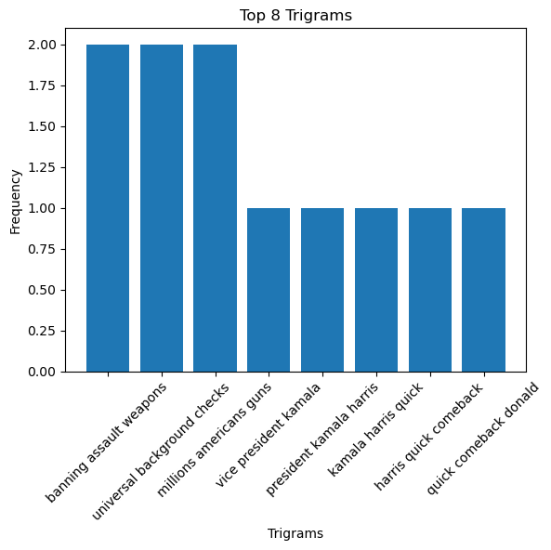
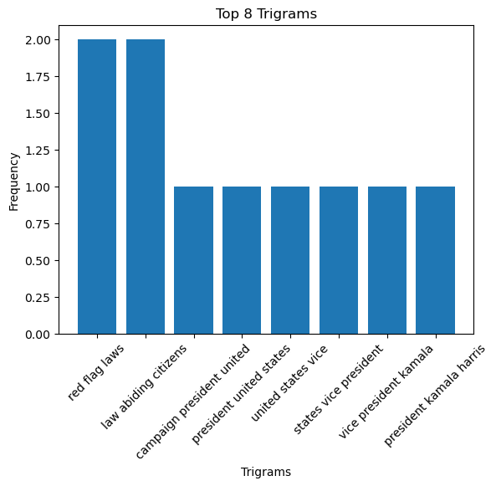
Comparing Guns

Slide 28
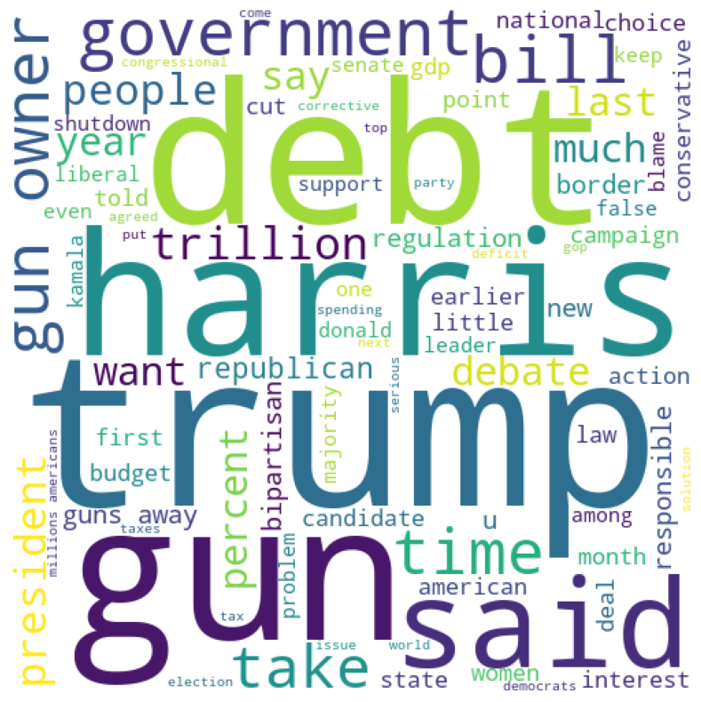
Liberal
Several words are more frequent than others
Certain words are emphasized a lot more than others
Key issues around ‘debt’,’harris’,’trump’ and ‘guns’

Slide 29
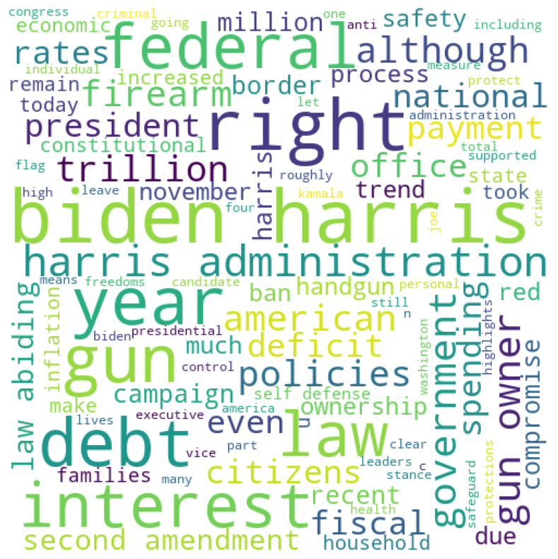
Conservative
Few words are pronounced
Word disparity is not as pronounced, words are mentioned at roughly same frequency
Little mention of Trump, strong focus on Biden-Harris

Slide 30
Conservative
Few words are pronounced
Word disparity is not as pronounced, words are mentioned at roughly same frequency
Little mention of Trump, strong focus on Biden-Harris
Trump?

Slide 31
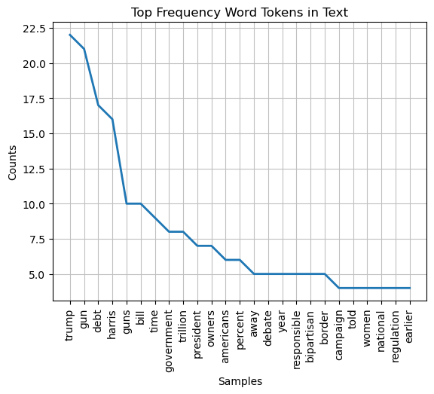
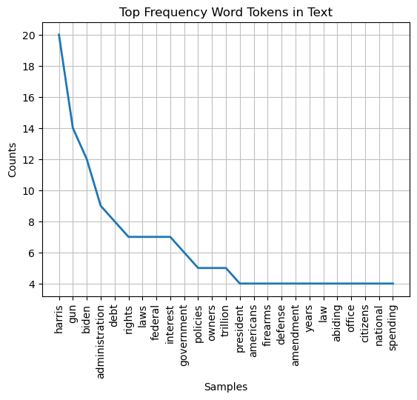
Word Frequencies

Slide 32
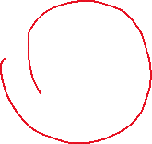

Word Frequencies
Shape of curve suggests right-leaning emphasize very few words

Slide 33
Findings
 | Left-Leaning | Right-Leaning | Both
Actors | Significant mention of Trump | Partial against Biden-Harris, little mention of Trump | Emphasize political regimes
Debt | More emphasis on spending | More emphasis on Biden-Harris | Feature some mention of parties
Border | Significant emphasis on Trump | Some emphasis on politics, but no mention of Trump | Feature some mention of parties
Guns | Emphasis on regulation and women | Emphasis on laws, rights, and defense | Mention ‘Americans’
Word Association | A couple words are regularly emphasized | Very few words stand out | Heavily stresses certain word/rhetoric

Slide 34
Methodology
 | Unigrams | Bigrams | Trigrams | WordCloud
Contextual Understanding | Effective in identifying values/frame | Moderate | Not effective. Not many trigrams present | Effective in identifying values/frame
Complexity | Simple – easy to understand | Simple – easy to understand | Simple – easy to understand | Complex – difficult to interpret
Information Density | Moderate | Moderate | Light – little information attributed to few trigrams | Dense
Advantage | Simple, easy to interpret, highlights details quickly | Same as unigram; highlights compound words | Effective in finding phrases or emphasized clusters | Birds-eye view of data. Easy to spot textual emphasis and values
Disadvantage | Strong bias for adjectives (e.g. ‘gun’ owners) | Leaves out important words that are not bigrams | Very sparse findings due to infrequency of trigrams | Difficult to extract further information

Slide 35
Text Analysis

Slide 36
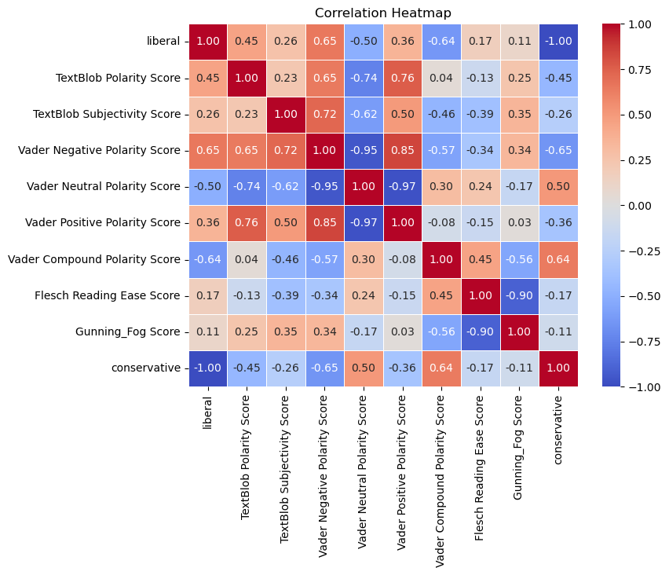
Correlation

Slide 37
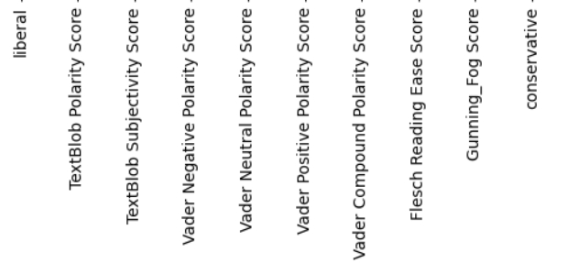
Correlation

Slide 38
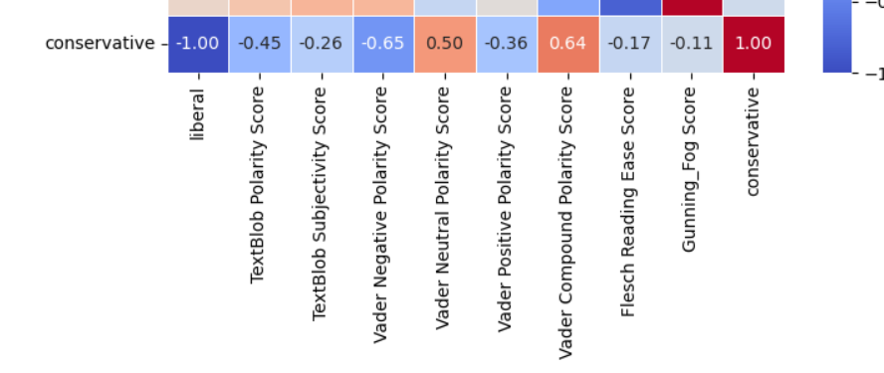
Correlation

Slide 39
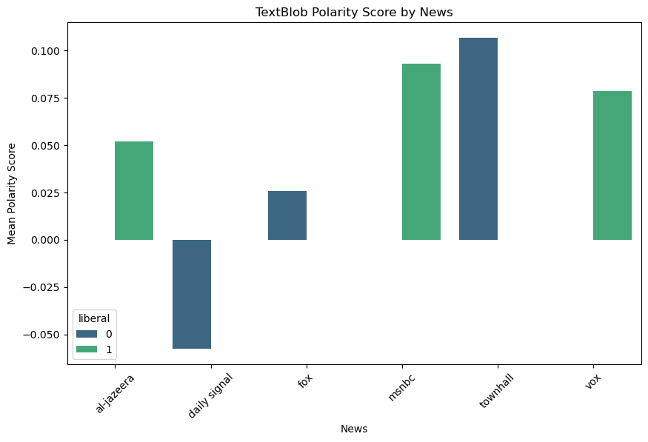
News Comparison

Slide 40
News Comparison
Conservative leaning has most positive sentiment and most negative sentiment

Slide 41



News Comparison
Left-Leaning news are generally more positive leaning, as shown by its positive value.
Important to still note that the range of TextBlob polarity is [-1,1]. While positive trending, actually closer to neutral.

Slide 42
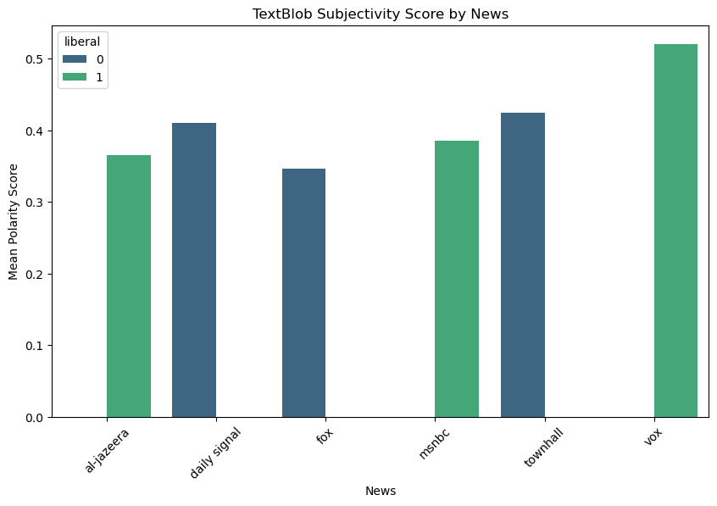
News Comparison

Slide 43

News Comparison
TextBlob Subjectivity Range [0,1]
Most are generally closer to 0.4, which suggests a balance between subjective and objective.
Al-Jazeera and Fox seem to be relatively more objective while Vox is the most subjective.

Slide 44
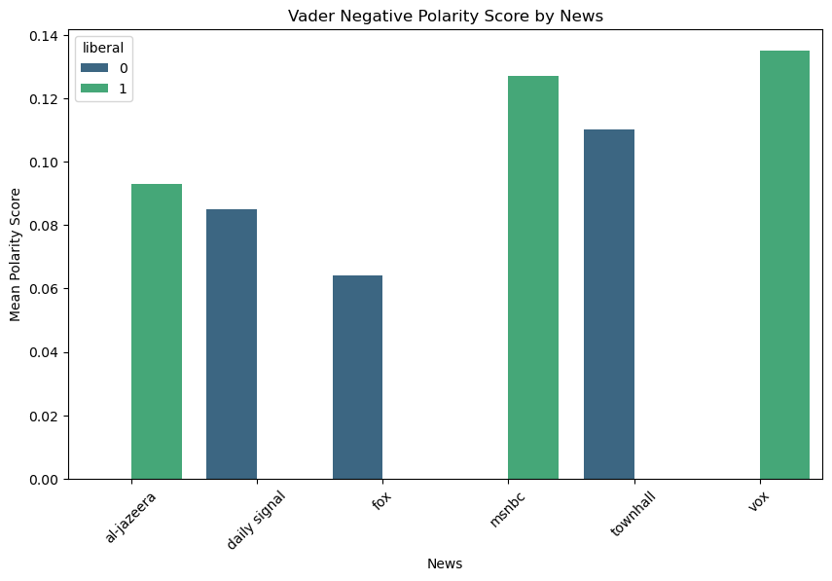
News Comparison

Slide 45
News Comparison
Comparatively, left-leaning outlets are more negative based on vader negative polarity.
You can see from the chart that the leftist media are comparatively higher.
While Al-Jazeera is less negative that townhall, it still more negative than fox or daily signal.

Slide 46
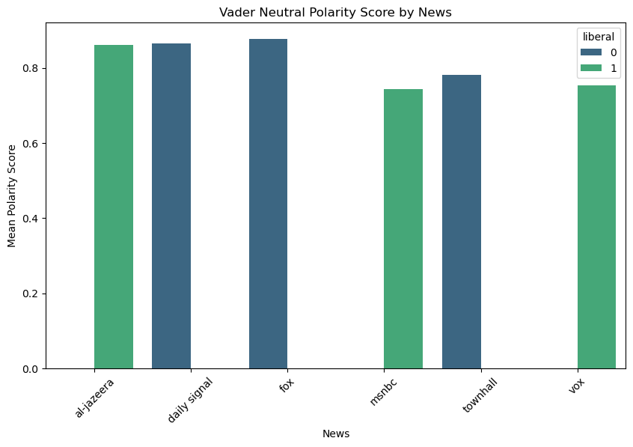
News Comparison

Slide 47
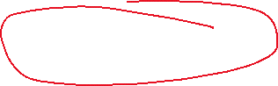

News Comparison
Vader Neutral Polarity range [0,1] with 1 being most neutral.
Overall, most news sources are quite neutral, with the Al Jazeera, Daily Signal, and Fox being close to 1.

Slide 48
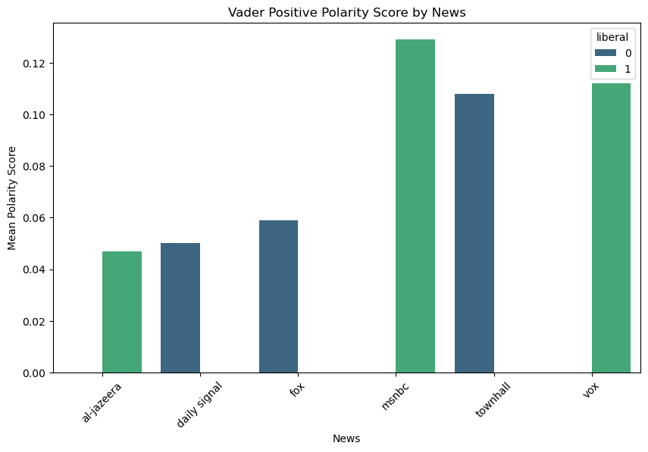
News Comparison

Slide 49

News Comparison
MSNBC is most positive polarity while Al-Jazeera is least positive.

Slide 50
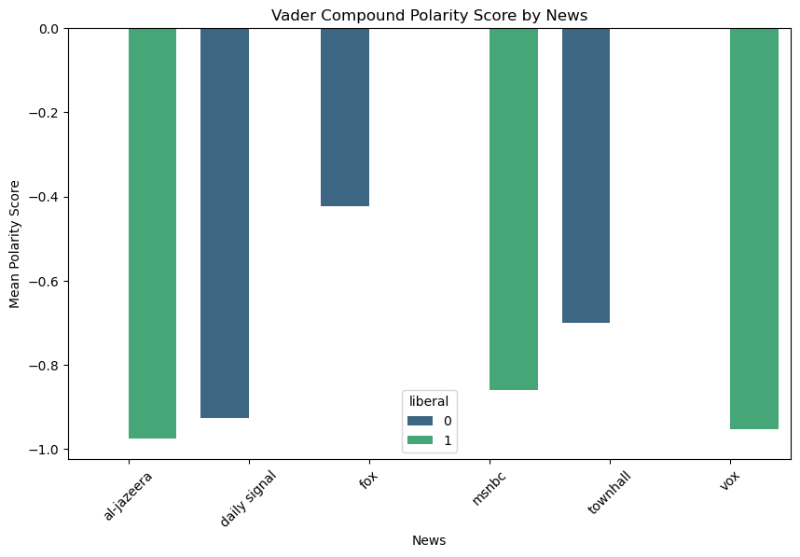
News Comparison
Vader Compound aggregates the previous scores into a range between [-1,1].
This aggregate score suggests that both (and potentially any) news are generally negatively.
Fox surprisingly is relatively less negative.

Slide 51
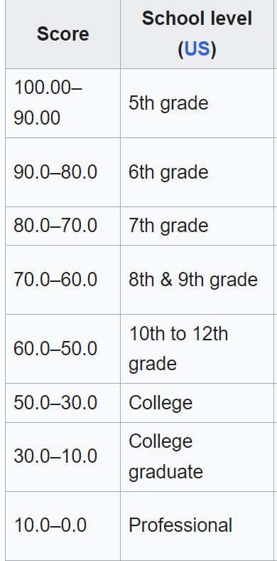
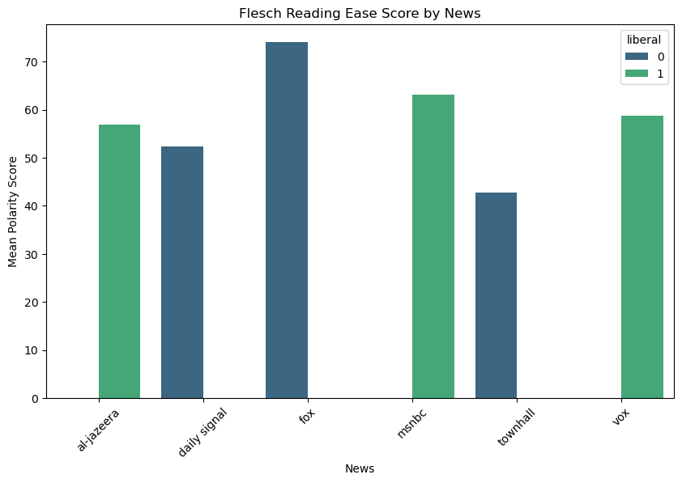
News Comparison

Slide 52
News Comparison

Slide 53
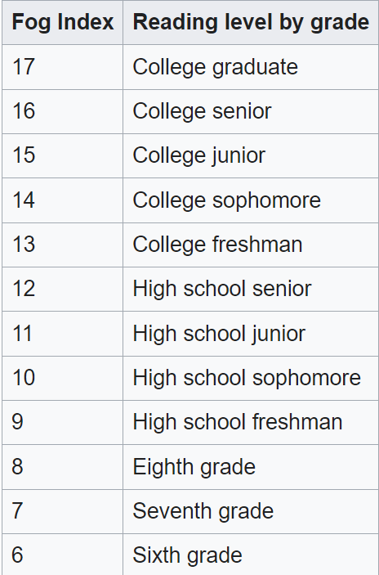
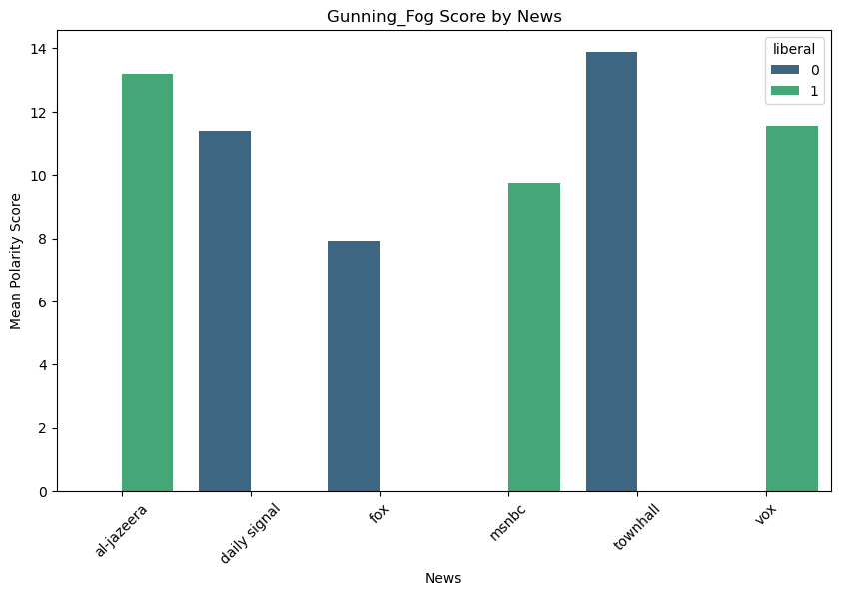
News Comparison

Slide 54


News Comparison

Slide 55
Results
 | Meaning | Findings | Interpretations
TextBlob Polarity Range [-1,1] | -1 = Negative Sentiment 0 = Neutral Sentiment 1 = Positive Sentiment | Conservative have highest and lowest score. Liberals have generally positive scores. Overall, centered around neutral. | Sentiments are mostly neutral. However, this score disagrees with Vader Score, as left-leaning is negative for Vader, suggesting a different scoring method.
TextBlob Subjectivity Range[0,1] | 0 = Objective 1 = Subjective | Al-Jazeera and Fox are most objective. Vox is most subjective. | Al-Jazeera and Fox are objective, but all are balanced.
Vader Negative Polarity Score Range[0,1] | 0 = Least Negative 1 = Most Negative | Left-leaning media overall more negative than right-leaning. | This disagrees with textblob, which found left to be more positive.
Vader Neutral Polarity Score Range[0,1] | 0 = Least Neutral 1 = Most Neural | Al-Jazeera, Daily Signal and Fox are most neutral. | This agrees with TextBlob. Al-Jazeera and Fox are neutral, objective.
Vader Positive Polarity Range[0,1 | 0 = Least Positive 1 = Most Positive | MSNBC most positive while Al-Jazeera is least positive. | Some disagreement with Textblob, where Al-Jazeera was positive.
Vader Compound Polarity Range[0,1 | -1 = Strong Negative 0 = Neural 1 = Strong Positive | All news tend towards negative, but left-leaning has stronger stronger negative. | Disagrees with textblob considerably, which found all news slightly positive but close to neutral.
Flesch Reading Ease Score Range[0,100] | 0 = Hard to Read 100 = Easy to Read | Fox is at a middle school reading level, while MSNBC is at high school. | This agrees with Gunning Fog.
Gunning Fog Index Range[0,17] | 0 = No requirements 17 = Number years of education required to read | Al-Jazeera and townhall are at higher education reading level. | This agrees with Flesch Reading Ease.

Slide 56

Findings
Most news outlets are generally neutral and balanced between subjective and objective, but it is inconclusive if they are leaning more positive or more negative.
Big news networks like Fox and MSNBC have a lower reading level, likely to reach popular appeal.

Slide 57
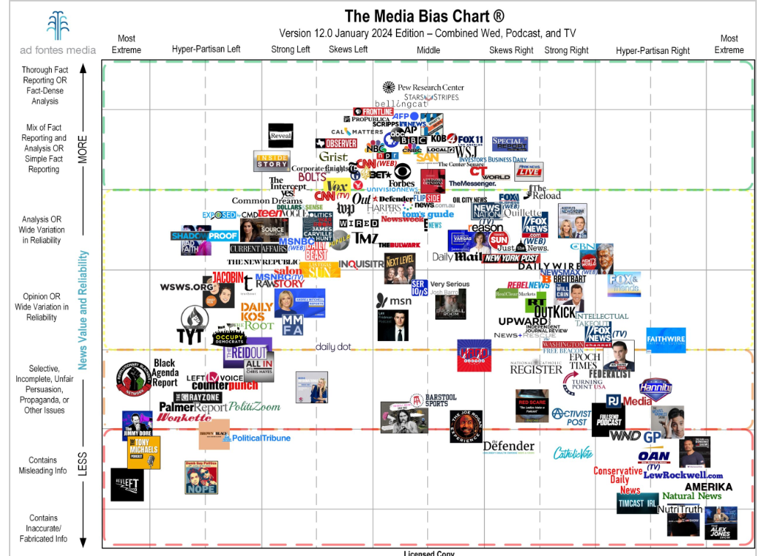




Investigating Moderates News
Selected Moderate Media Sources
Chart from Ad Fontes Media

Slide 58
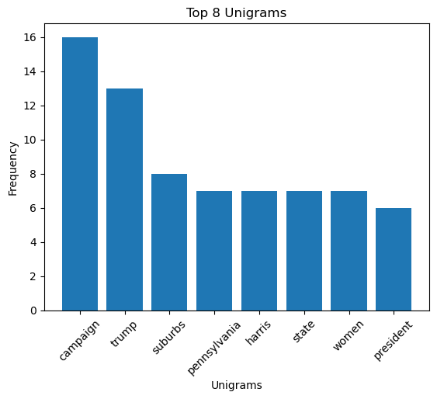
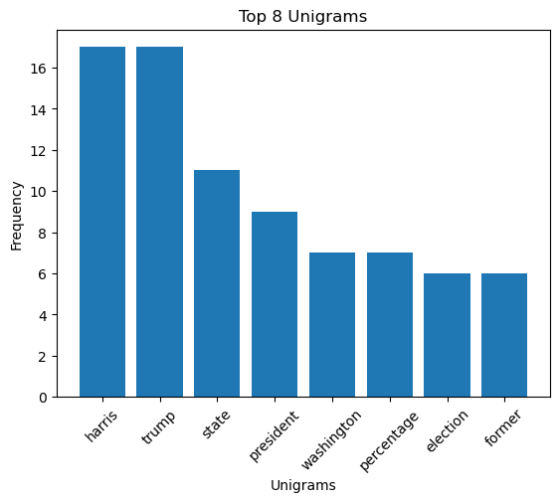
Comparing Unigrams

Slide 59





Comparing Unigrams
Some bias remains…
But among moderate news, equal mention of trump and harris shows deviation from left/right-leaning news

Slide 60




Comparing Unigrams
Emerging pattern of similar frequency for Trump and Harris in another moderate news

Slide 61


Comparing Bigrams

Slide 62


Comparing Bigrams

Slide 63


Comparing Trigrams

Slide 64


Comparing Trigrams

Slide 65

Word Cloud

Slide 66
Word Cloud
Trump and Harris are both very similar in font size, i.e. frequency of occurrence.

Slide 67

Word Frequency

Slide 68


Word Frequency
Trump seems to be most frequent, but Harris is second highly mentioned.
This supports findings of equal representation within moderate media outlets.

Slide 69

Findings
Among moderate news outlets, certain news still retain a considerable level of bias. However, interesting emergence is the equal representation of both candidates on certain issues.
This is suggested by both the unigrams and word cloud, where you can see both candidates level in word frequency gram-charts and relatively similar font size in the word cloud.

Slide 70

TextBlob Polarity
Moderate Media are relatively more positive, per TextBlob
All news are closer to being neutral with the highest polarity score of 0.1 (polarity of zero denotes neutral)

Slide 71

TextBlob Subjectivity
- Moderate Media roughly same level of subjectivity, around 50:50 between purely objective and purely subjective with slight lean towards objective .

Slide 72

Vader Negative Score
Vader Score shows that Moderate News is comparatively less negative

Slide 73

Vader Neutral Score
Vader determines that Moderate is comparatively more neutral, but generally at similar levels with other news platforms

Slide 74

Vader Positive Score
Vader determines that moderates are less positive than liberal or conservative media
This finding is conflicts with TextBlob, likely due to scoring methodology

Slide 75

Vader Compound Score
Vader Compound Scores, which aggregates Positive, Neutral, and Negative determines that moderate is positive.
This is a strong contrast to liberal and conservative news.
This finding is also consistent with TextBlob.

Slide 76

Flesch Reading Ease Score

Slide 77


Flesch Reading Ease Score

Slide 78

Gunning Fog

Slide 79


Gunning Fog

Slide 80
Findings
Affiliation | Subjectivity-Objectivity | Positive-Negative | Reading Level
Left-Leaning | 50:50 | Somewhere between neutral and negative | High School
Right-Leaning | 50:50 | Somewhere between neutral and negative | High School
Moderate | 50:50 | Mostly positive | High School

Slide 81

Implications
Biased news media may influence polarization among voters in the upcoming election. The negative-leaning sentiments for left-leaning and right-leaning news outlets may influence voting along party lines rather than proper evaluation of candidates and platforms.
While most news outlets aim to write at a high school reading level to garner mass appeal, this may oversimplify high-level details or conceptual implications that are important to key issues.
The industry-wide finding of being 50:50 ratio for subjectivity to objectivity implies that no one news outlet will provide adequate comprehensive covered with the 50% subjectivity bias. It will be important for voters to consume a variety of reputable sources to have a complete picture.

